Slide 1

PROBLEM:
People forget to act on things that inspire them.
SOLUTION:
An inspiration diary with triggered reminders.

Slide 2
SIMPLE:
Darby usually remembers what grocery she needs when she’s running between classes. She’ll make a list & get a notification reminder when she enters a grocery store
MEDIUM:
David writes a popular blog. He has lots of conversations with people and wants to blog about things that intrigue him from these. He’ll jot down notes + take a picture for the blog post, setting a reminder for tomorrow morning when he is at his co­working space
COMPLEX:
Tina is an artist. She paints, draws, and does multimedia art. She is inspired by her environment, but this inspiration often comes to her when she is busy doing other things. She likes to log her inspiration in her notebook or on her phone in her Notes app, but often forgets to come back to her notes that she makes and forgets to act on that inspiration when it’s still fresh in her mind. She’ll set reminders to pull up inspiration when she is in her art studio, and will periodically scroll through her time series of inspiration when looking for inspiration.

Slide 3
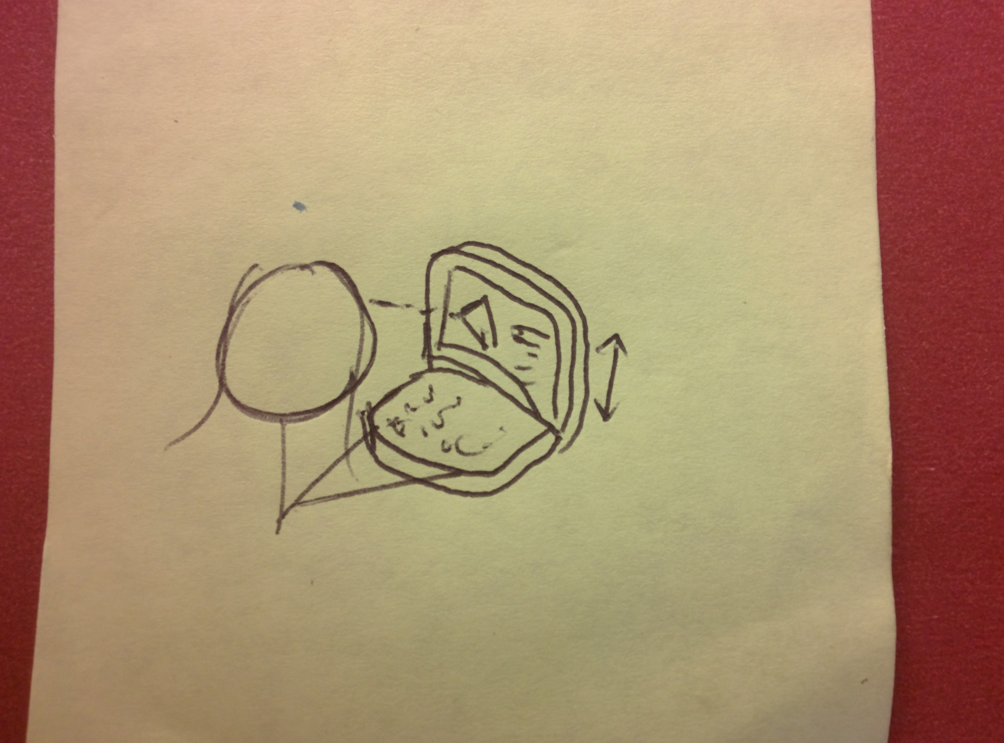
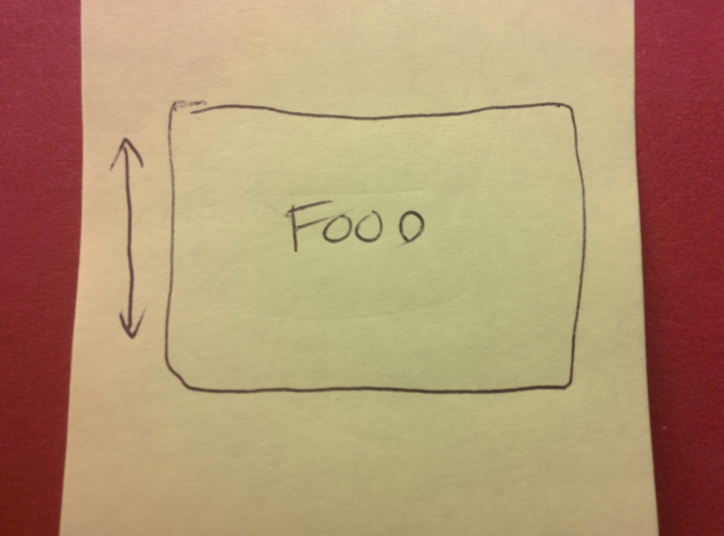
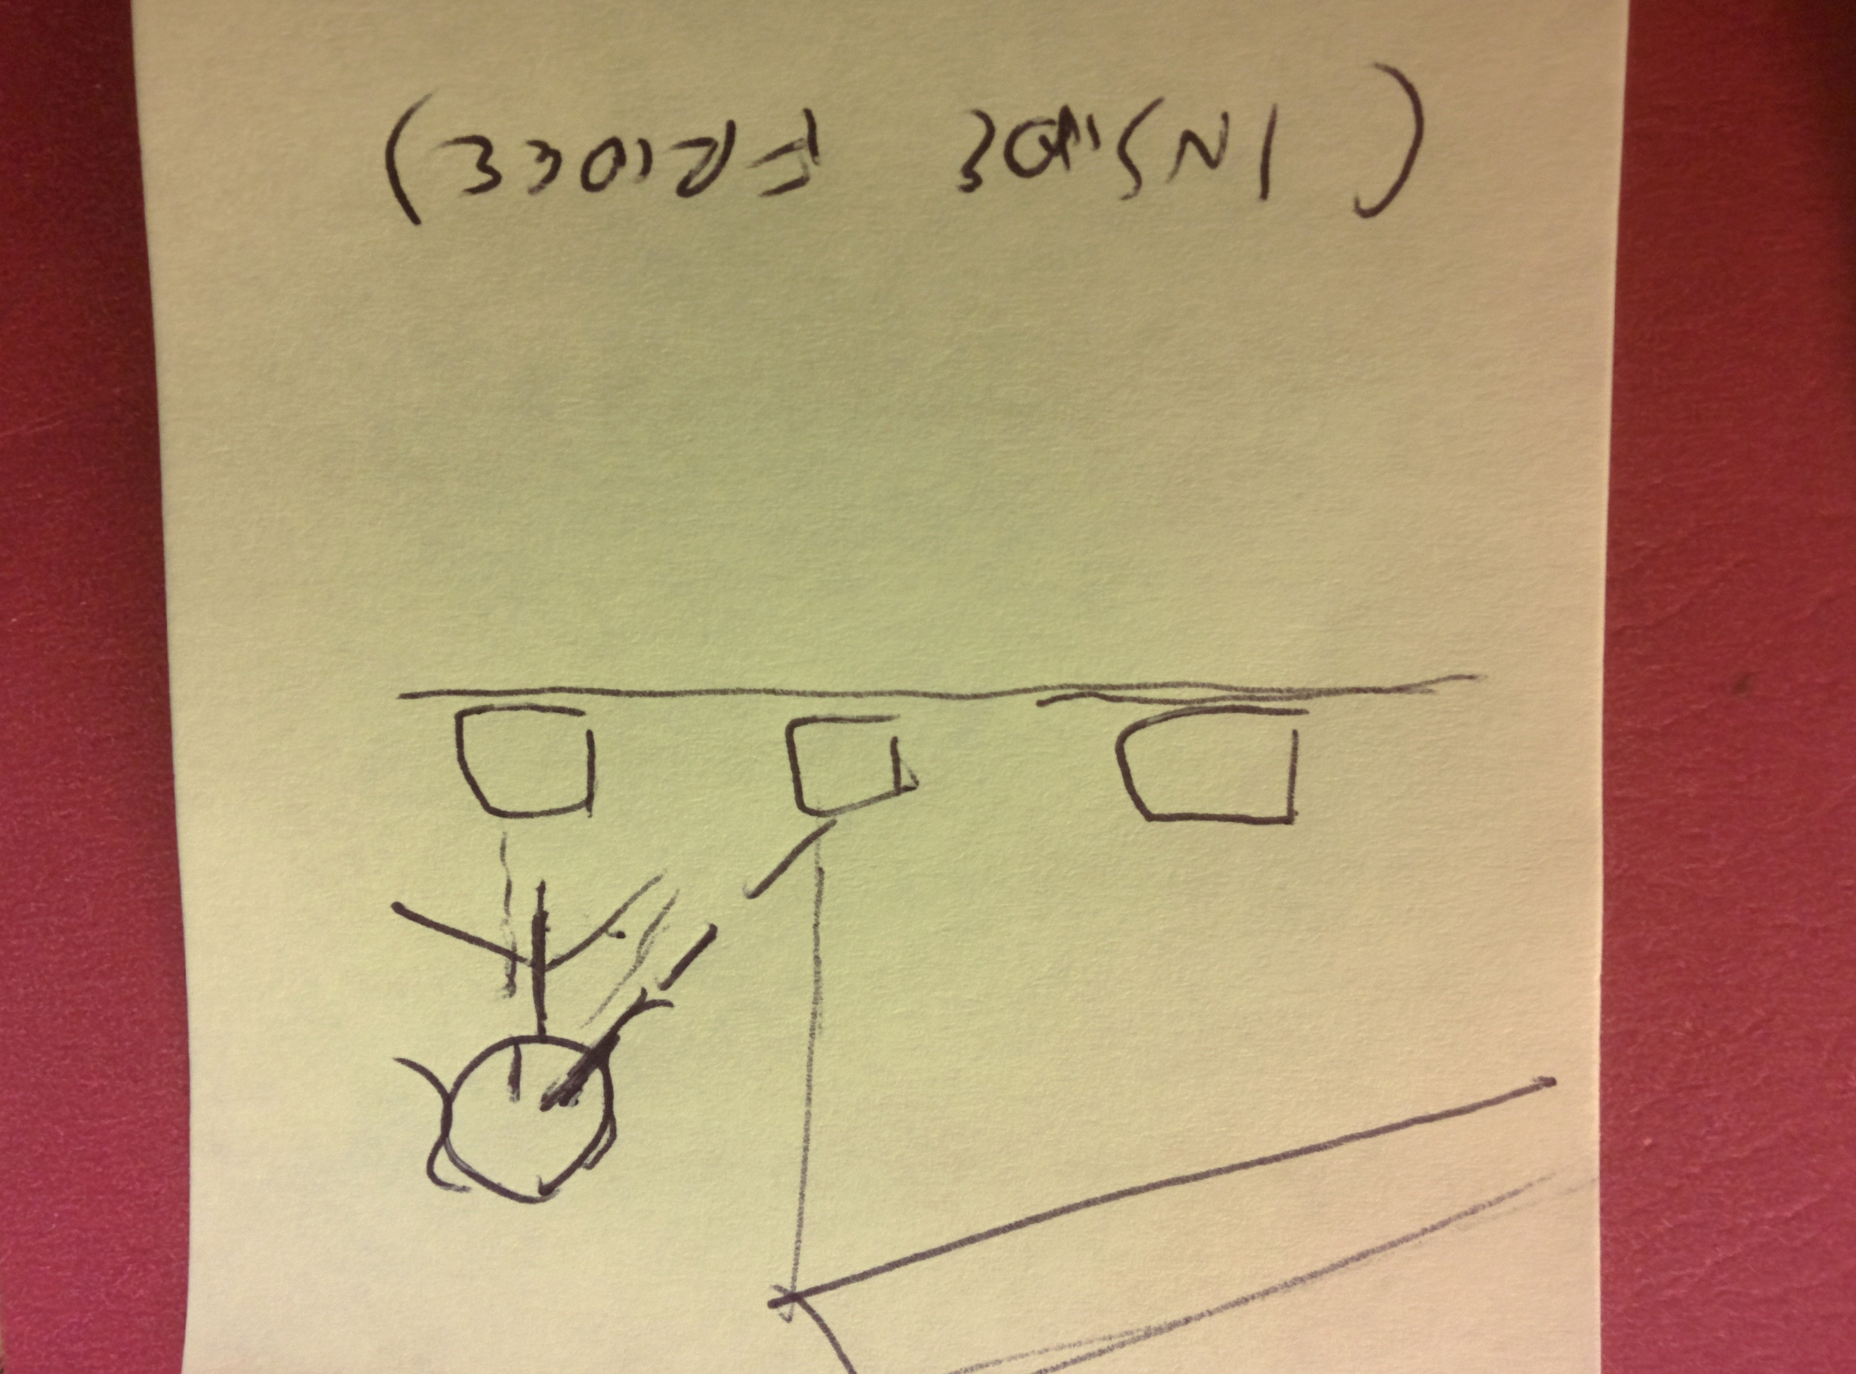
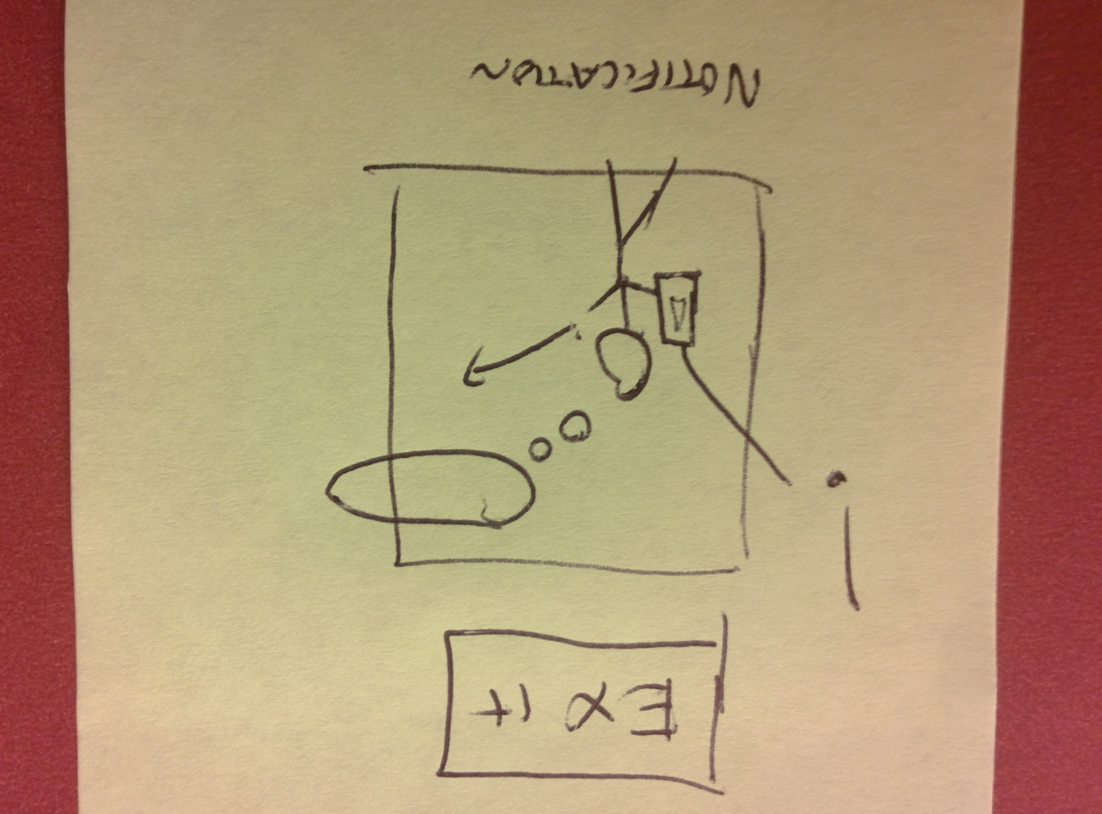
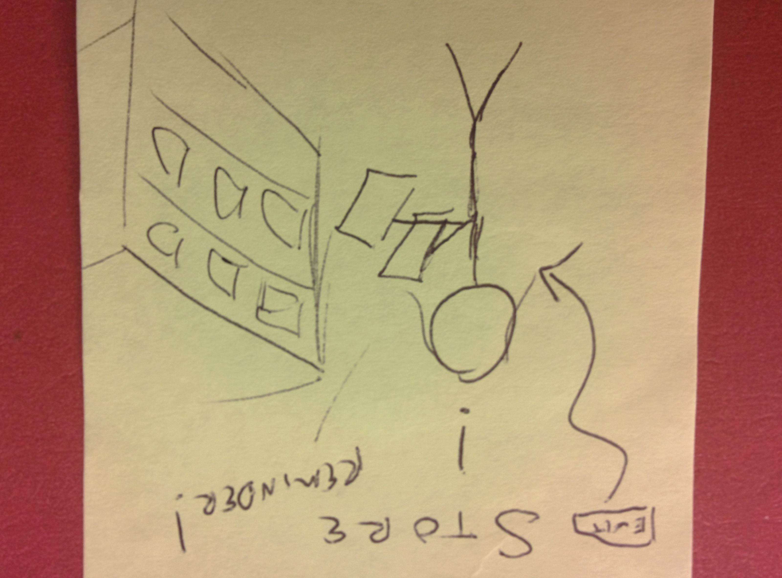
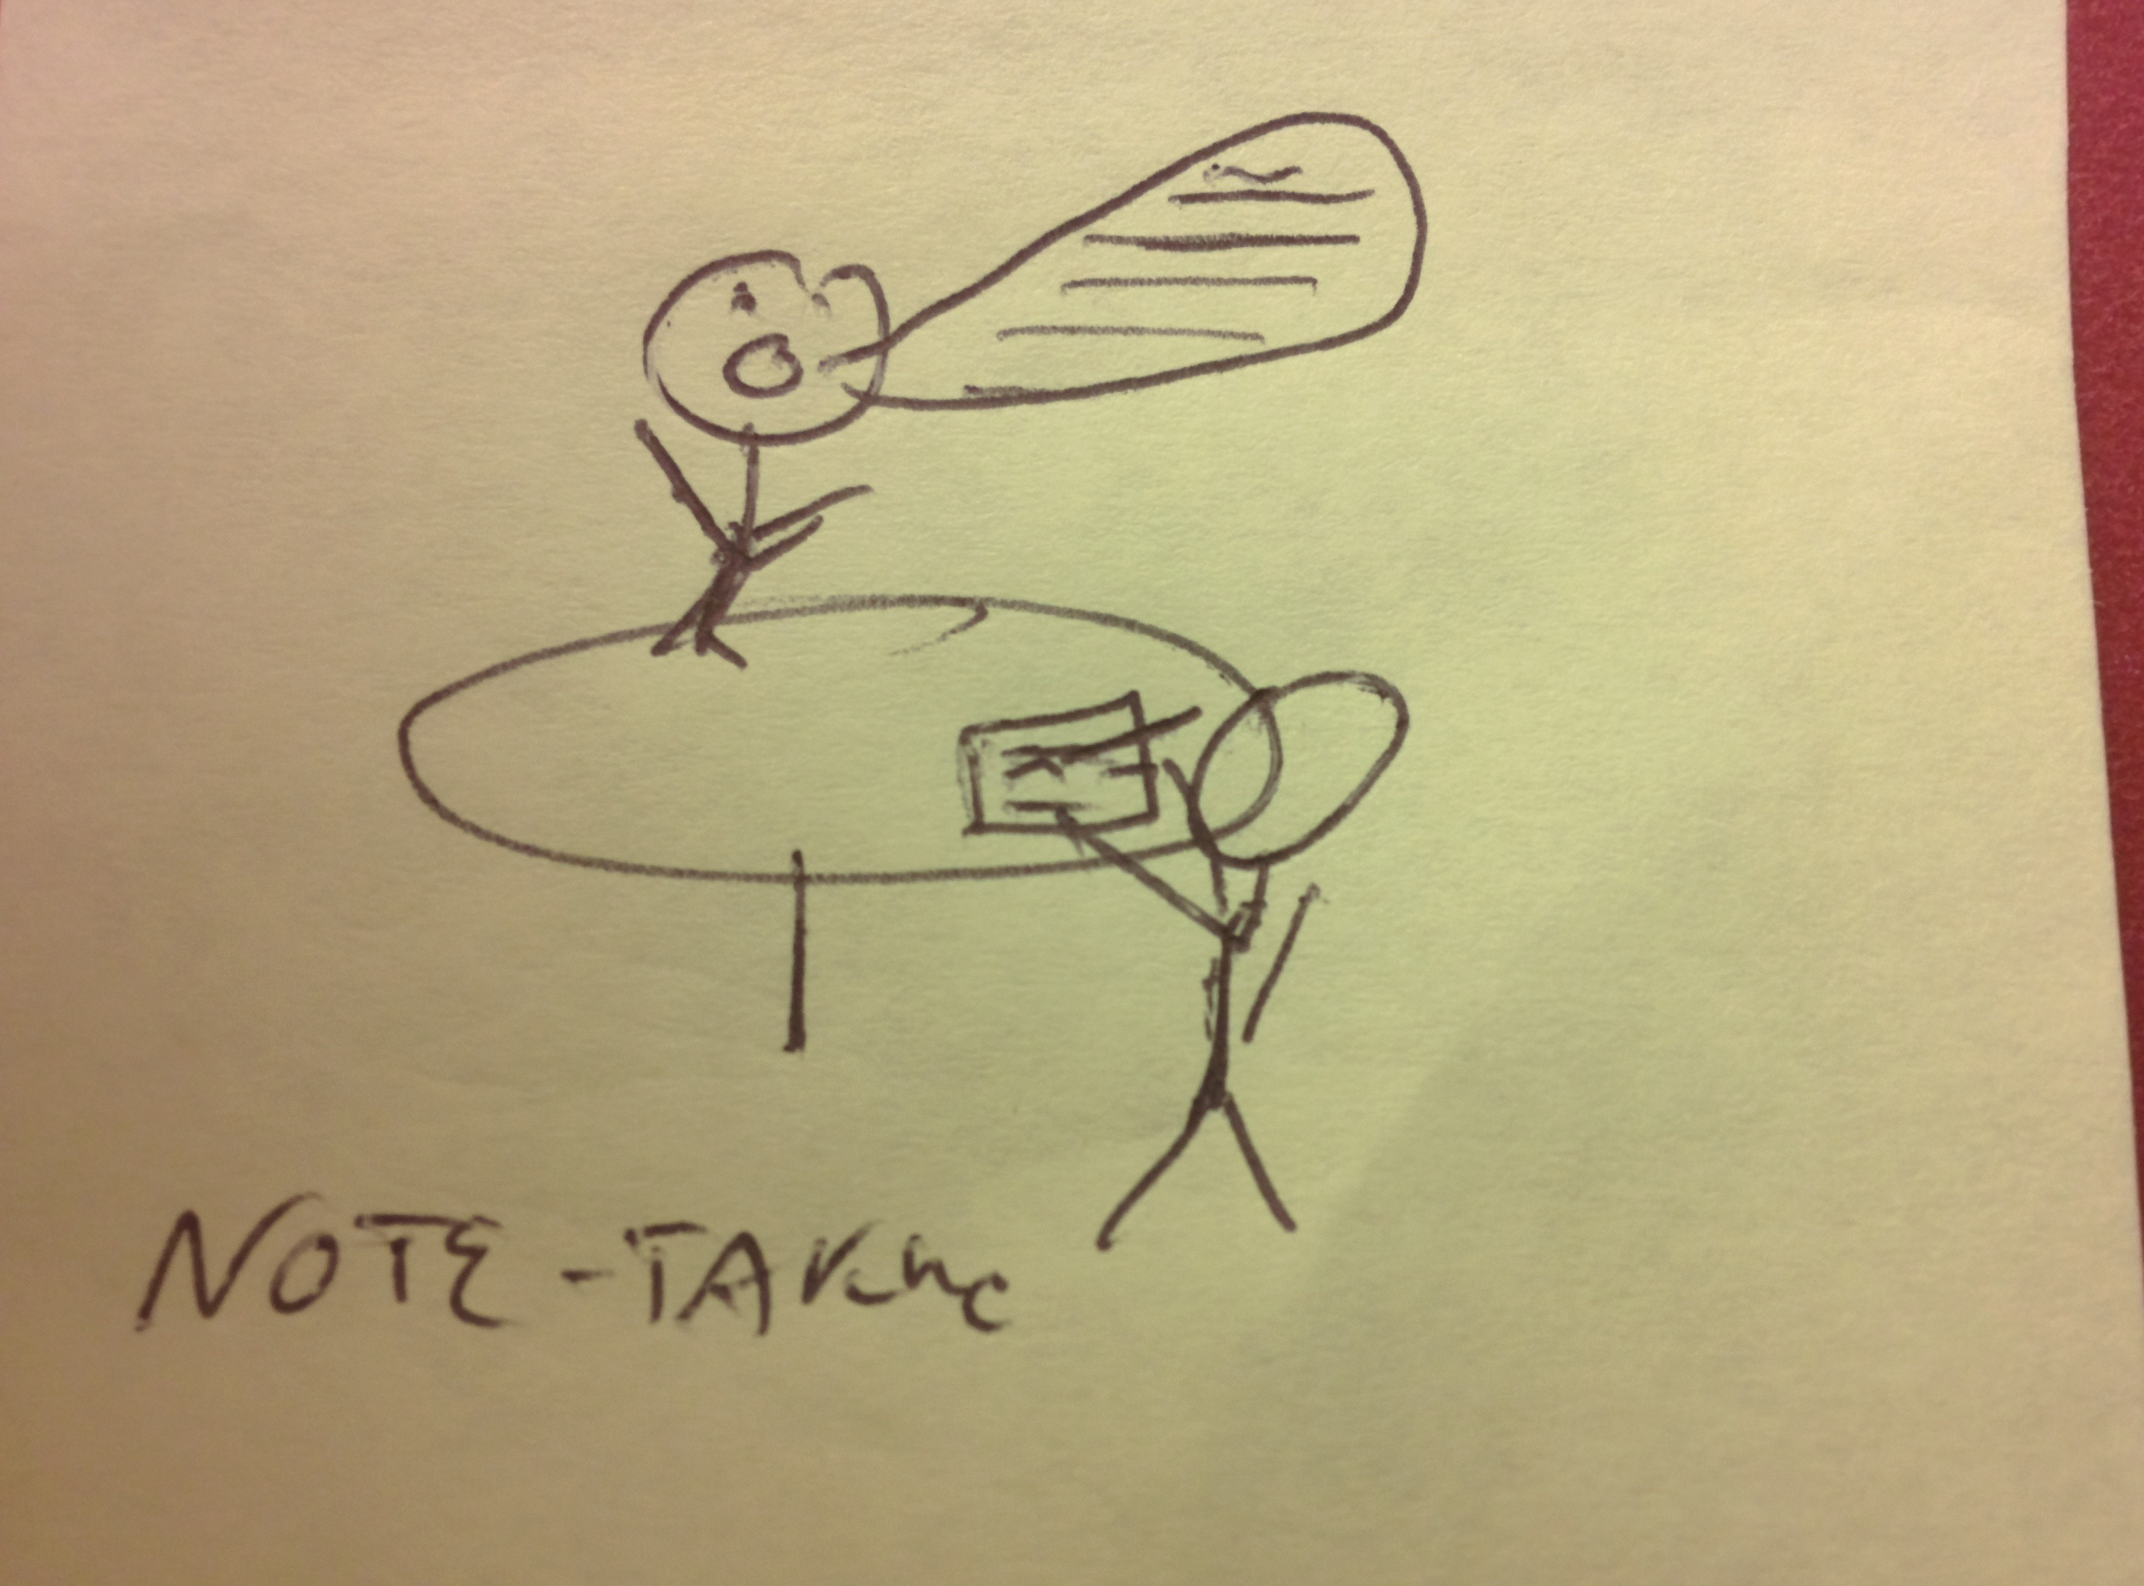
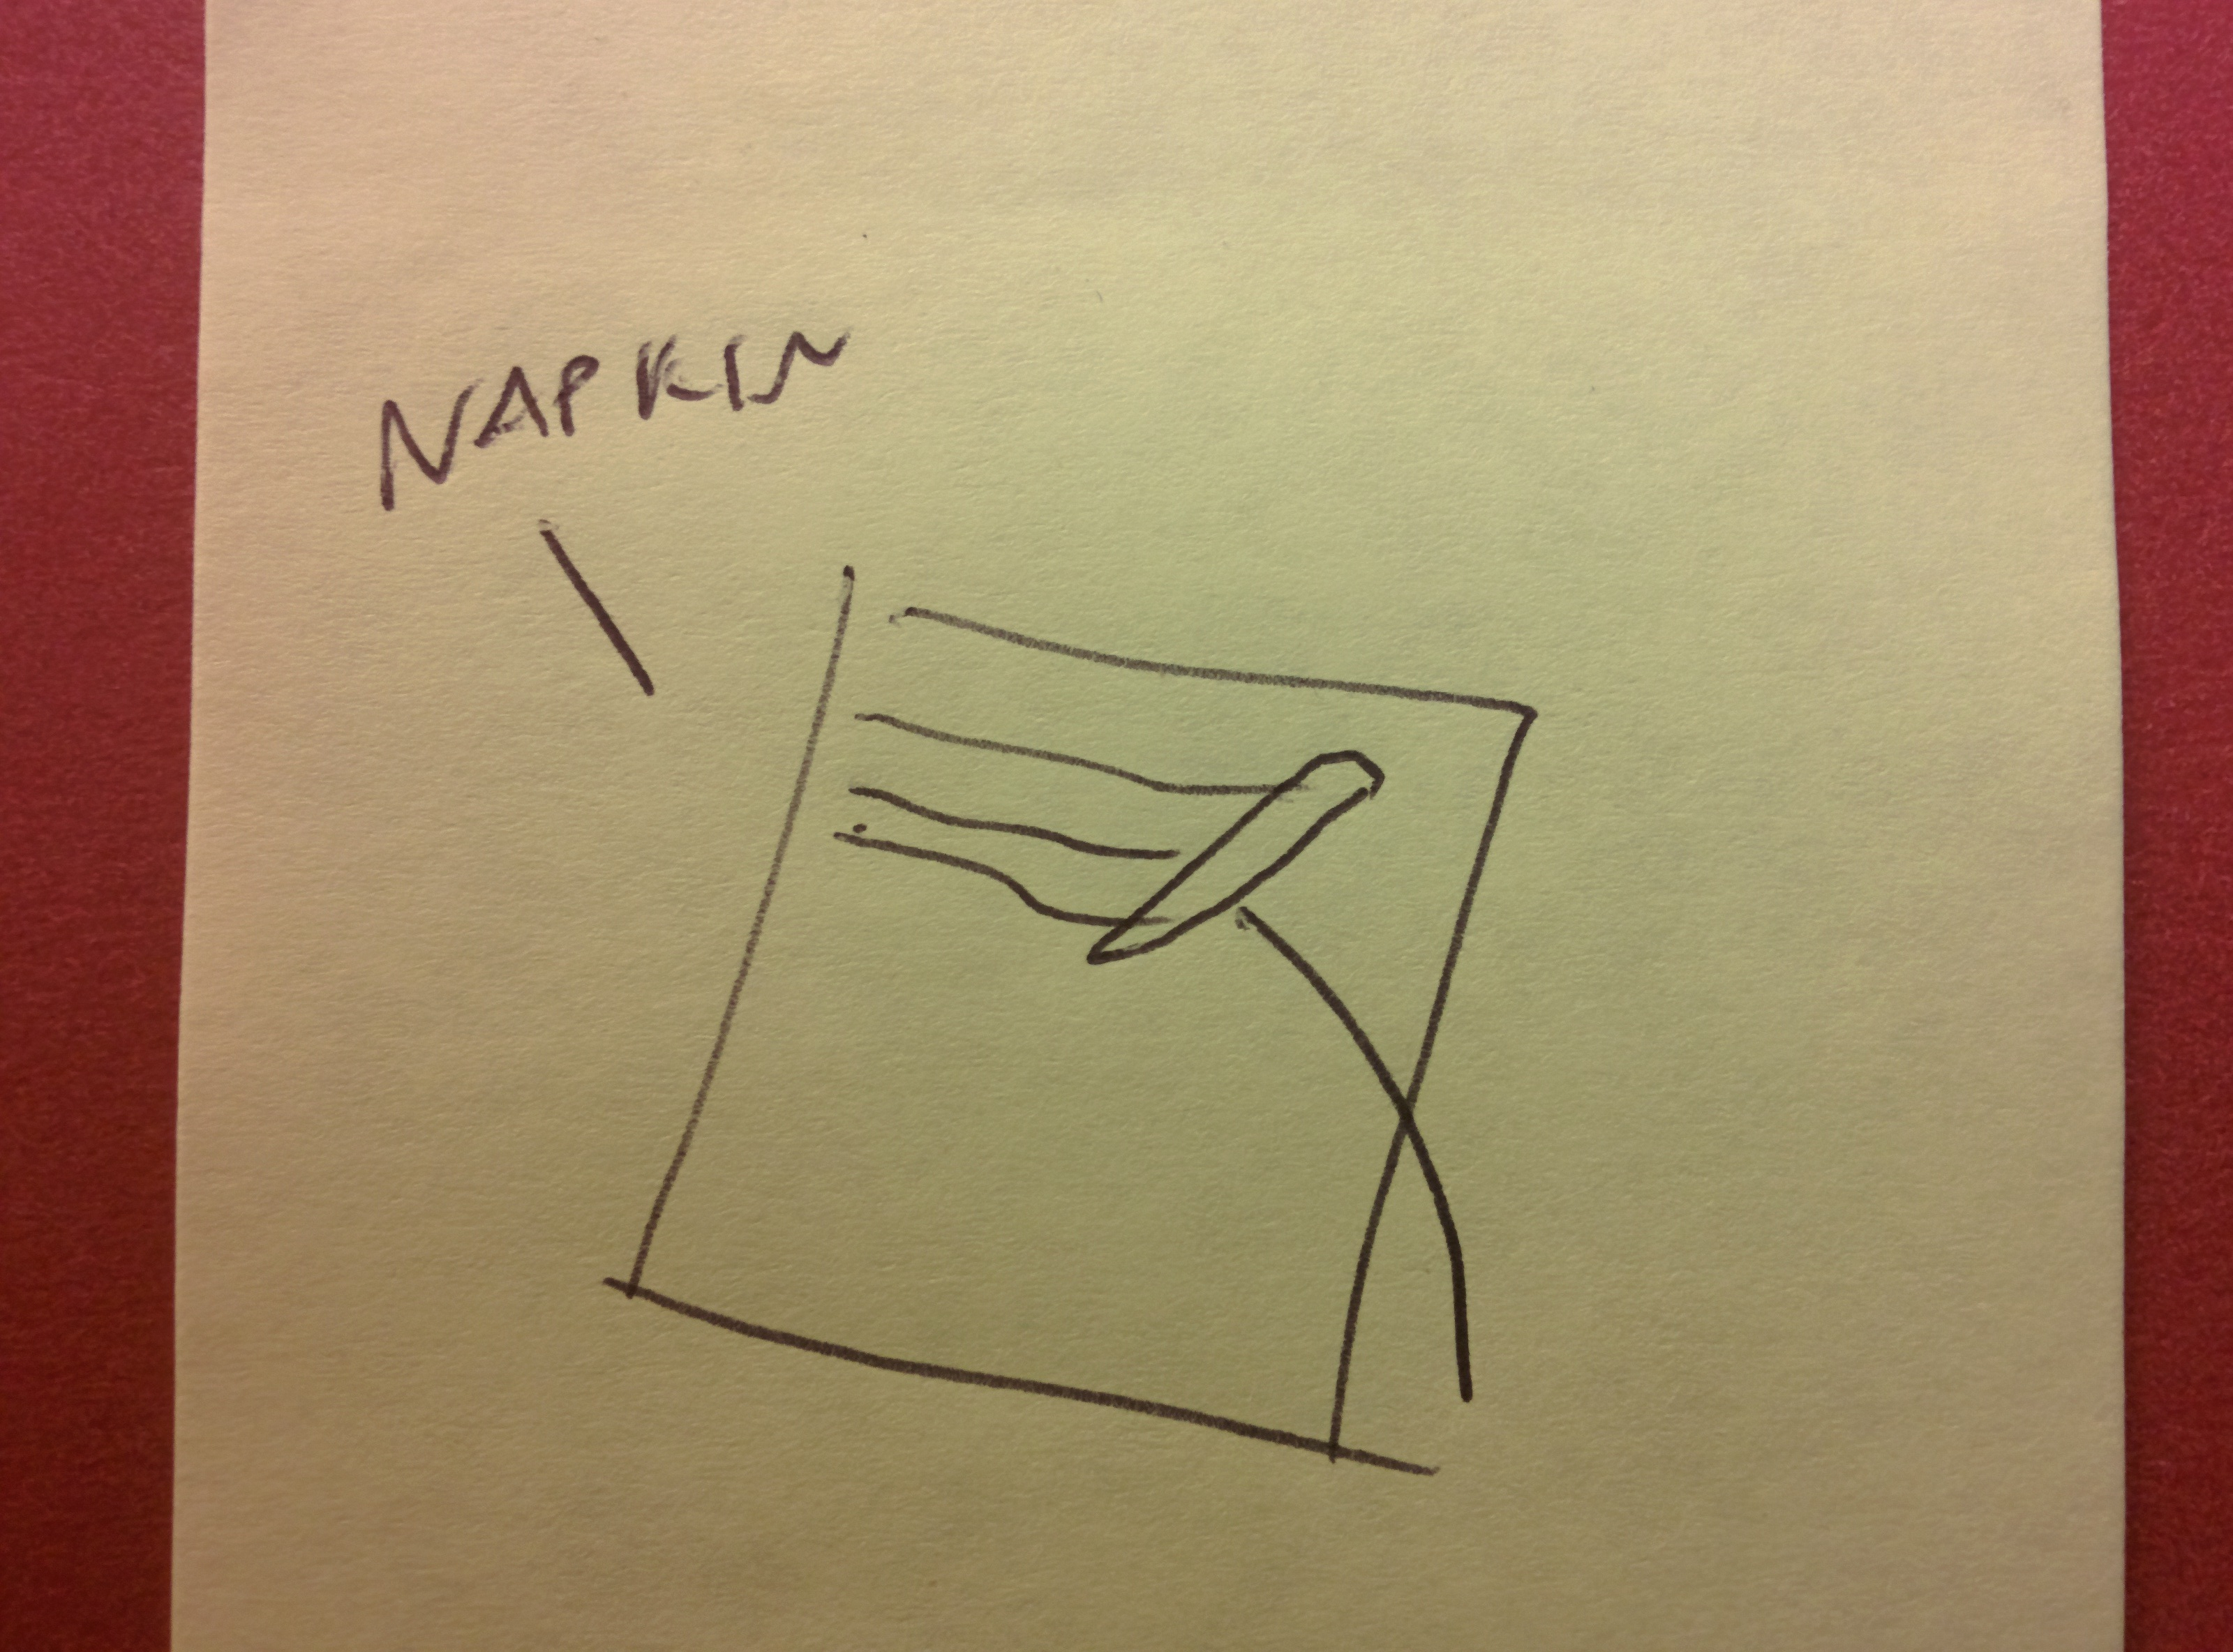
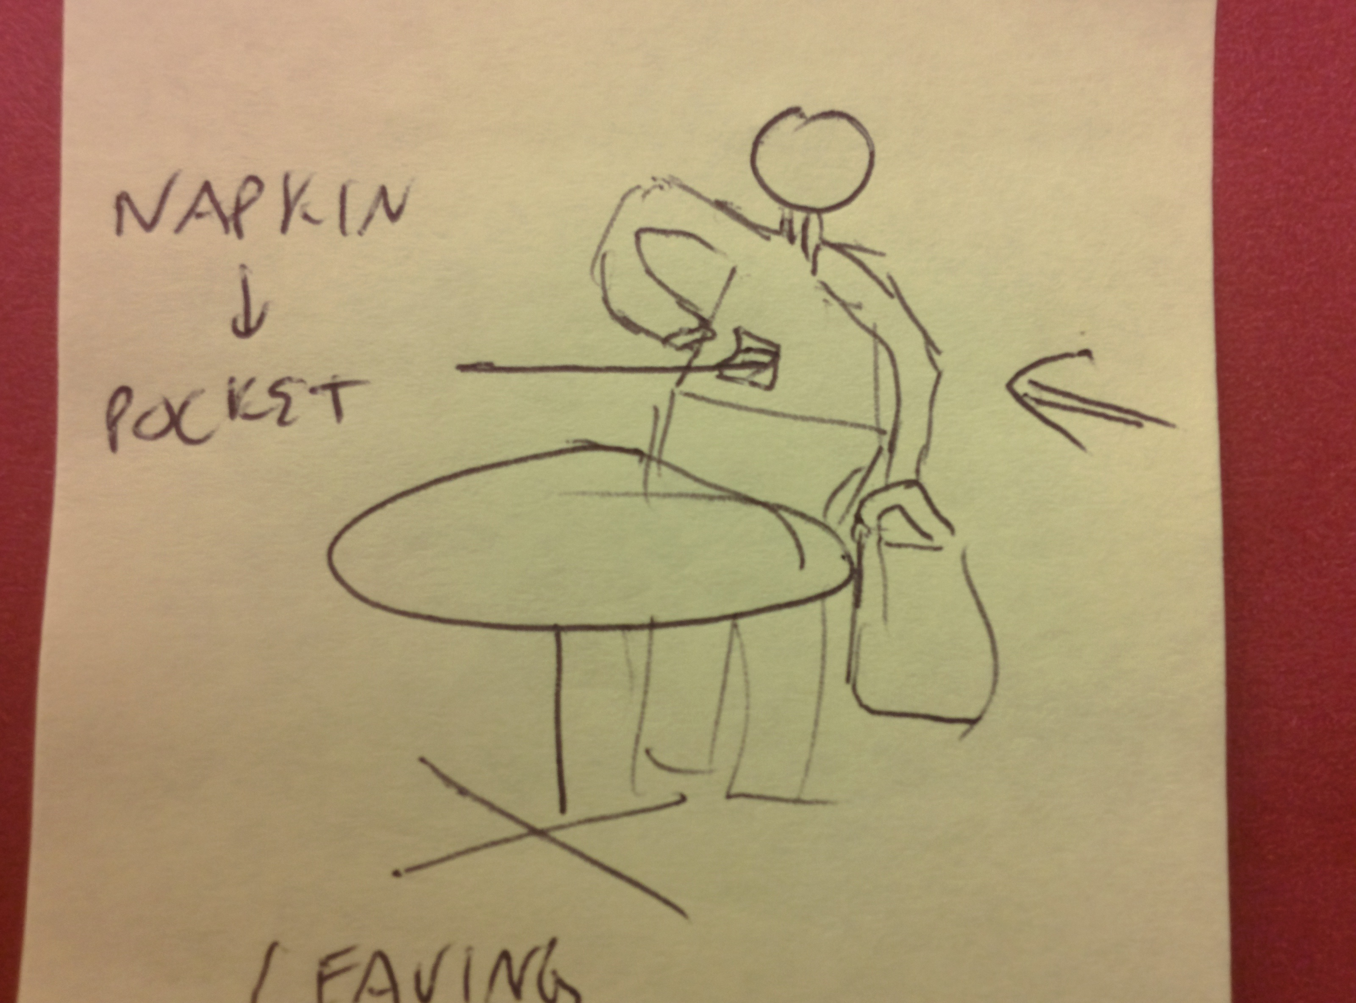
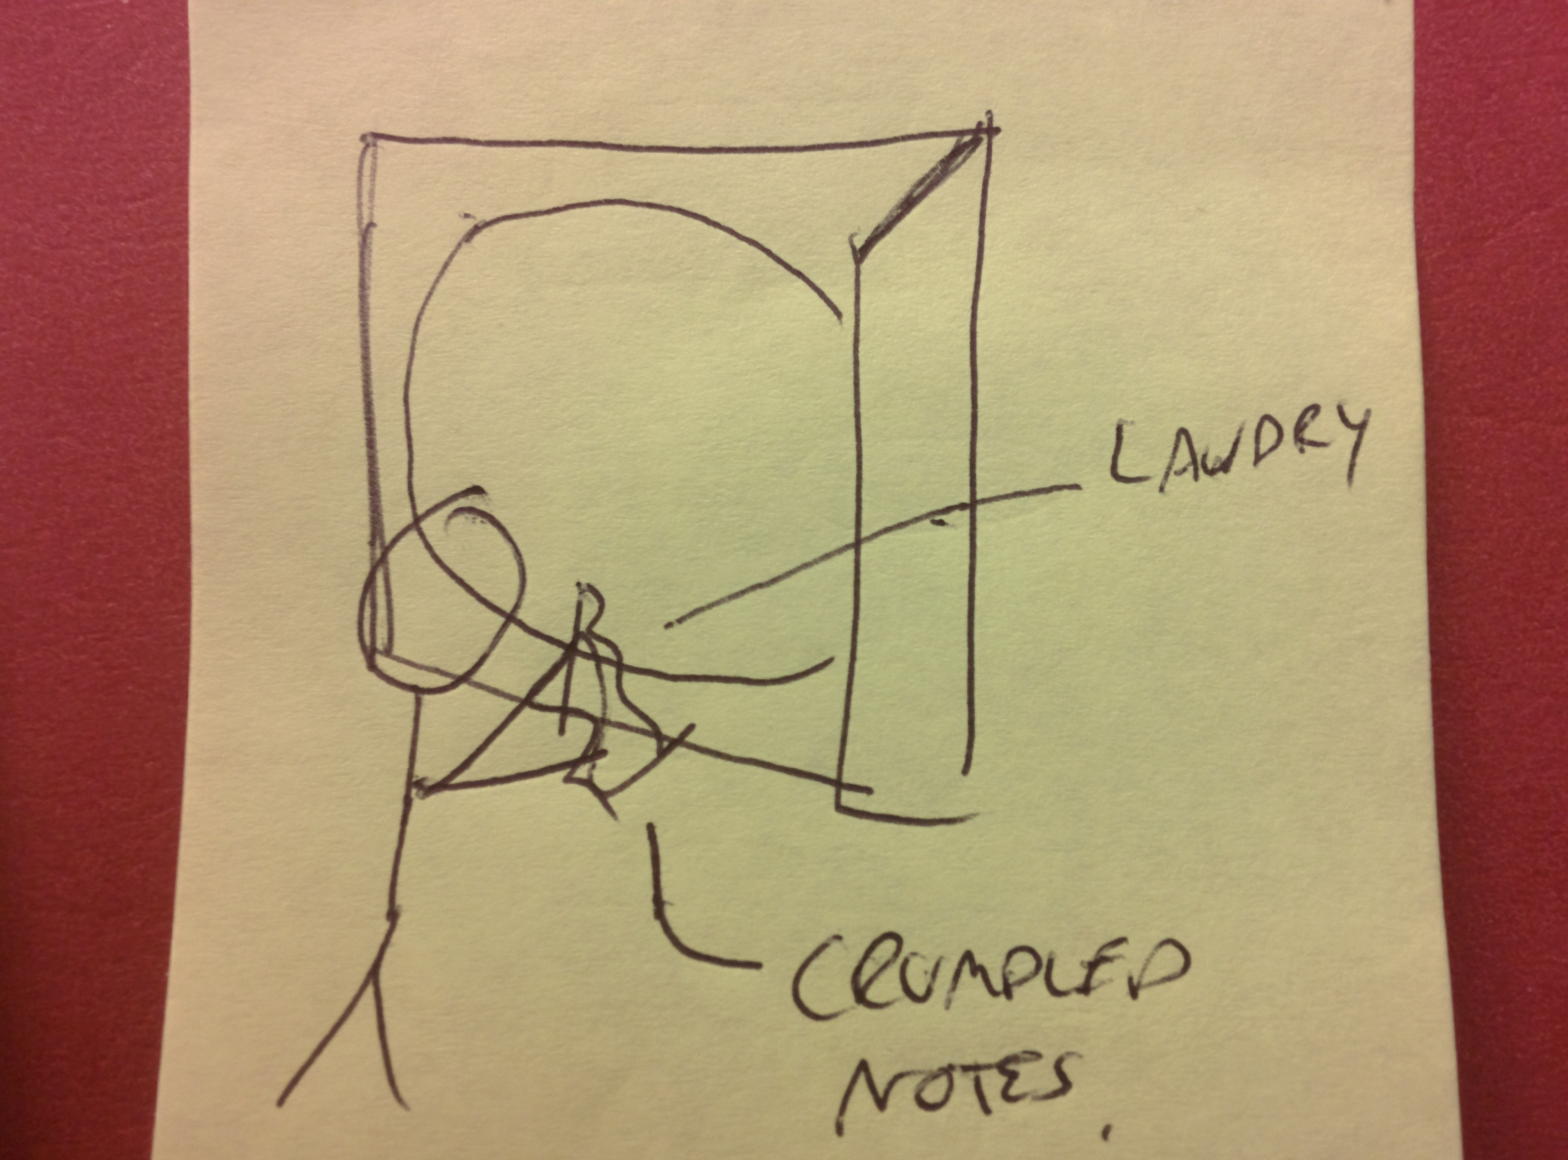
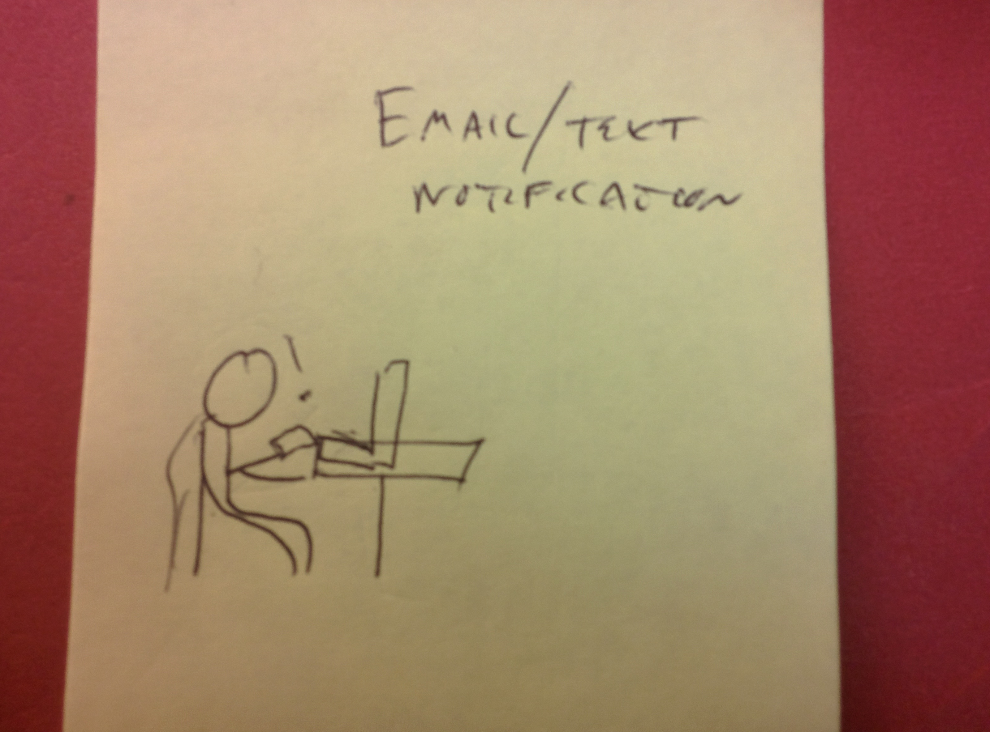
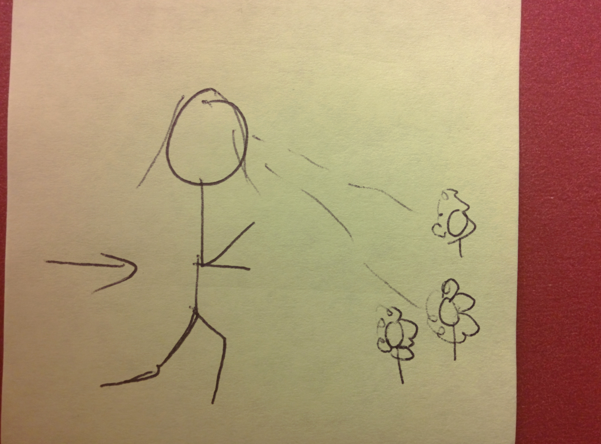
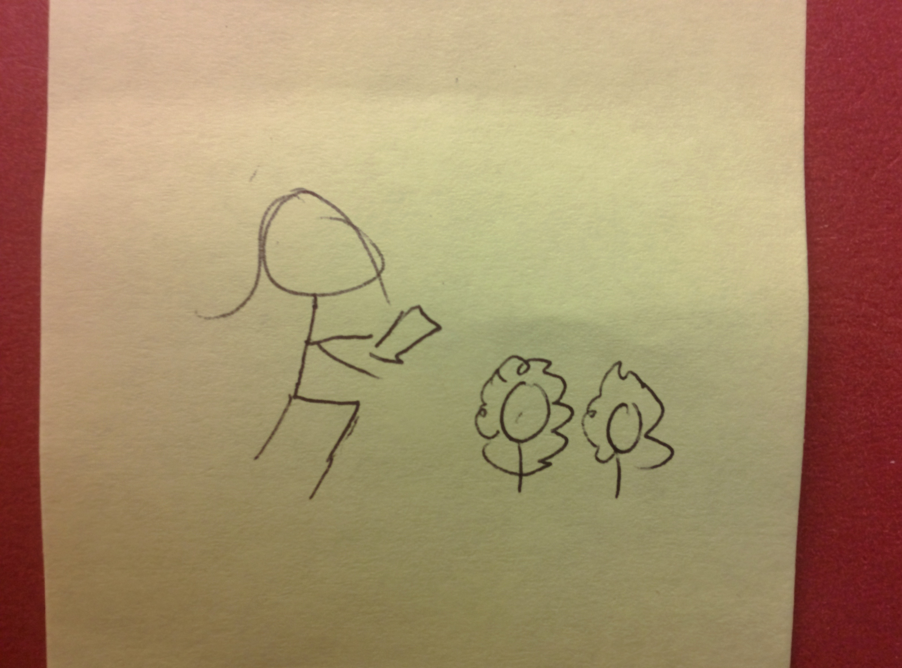
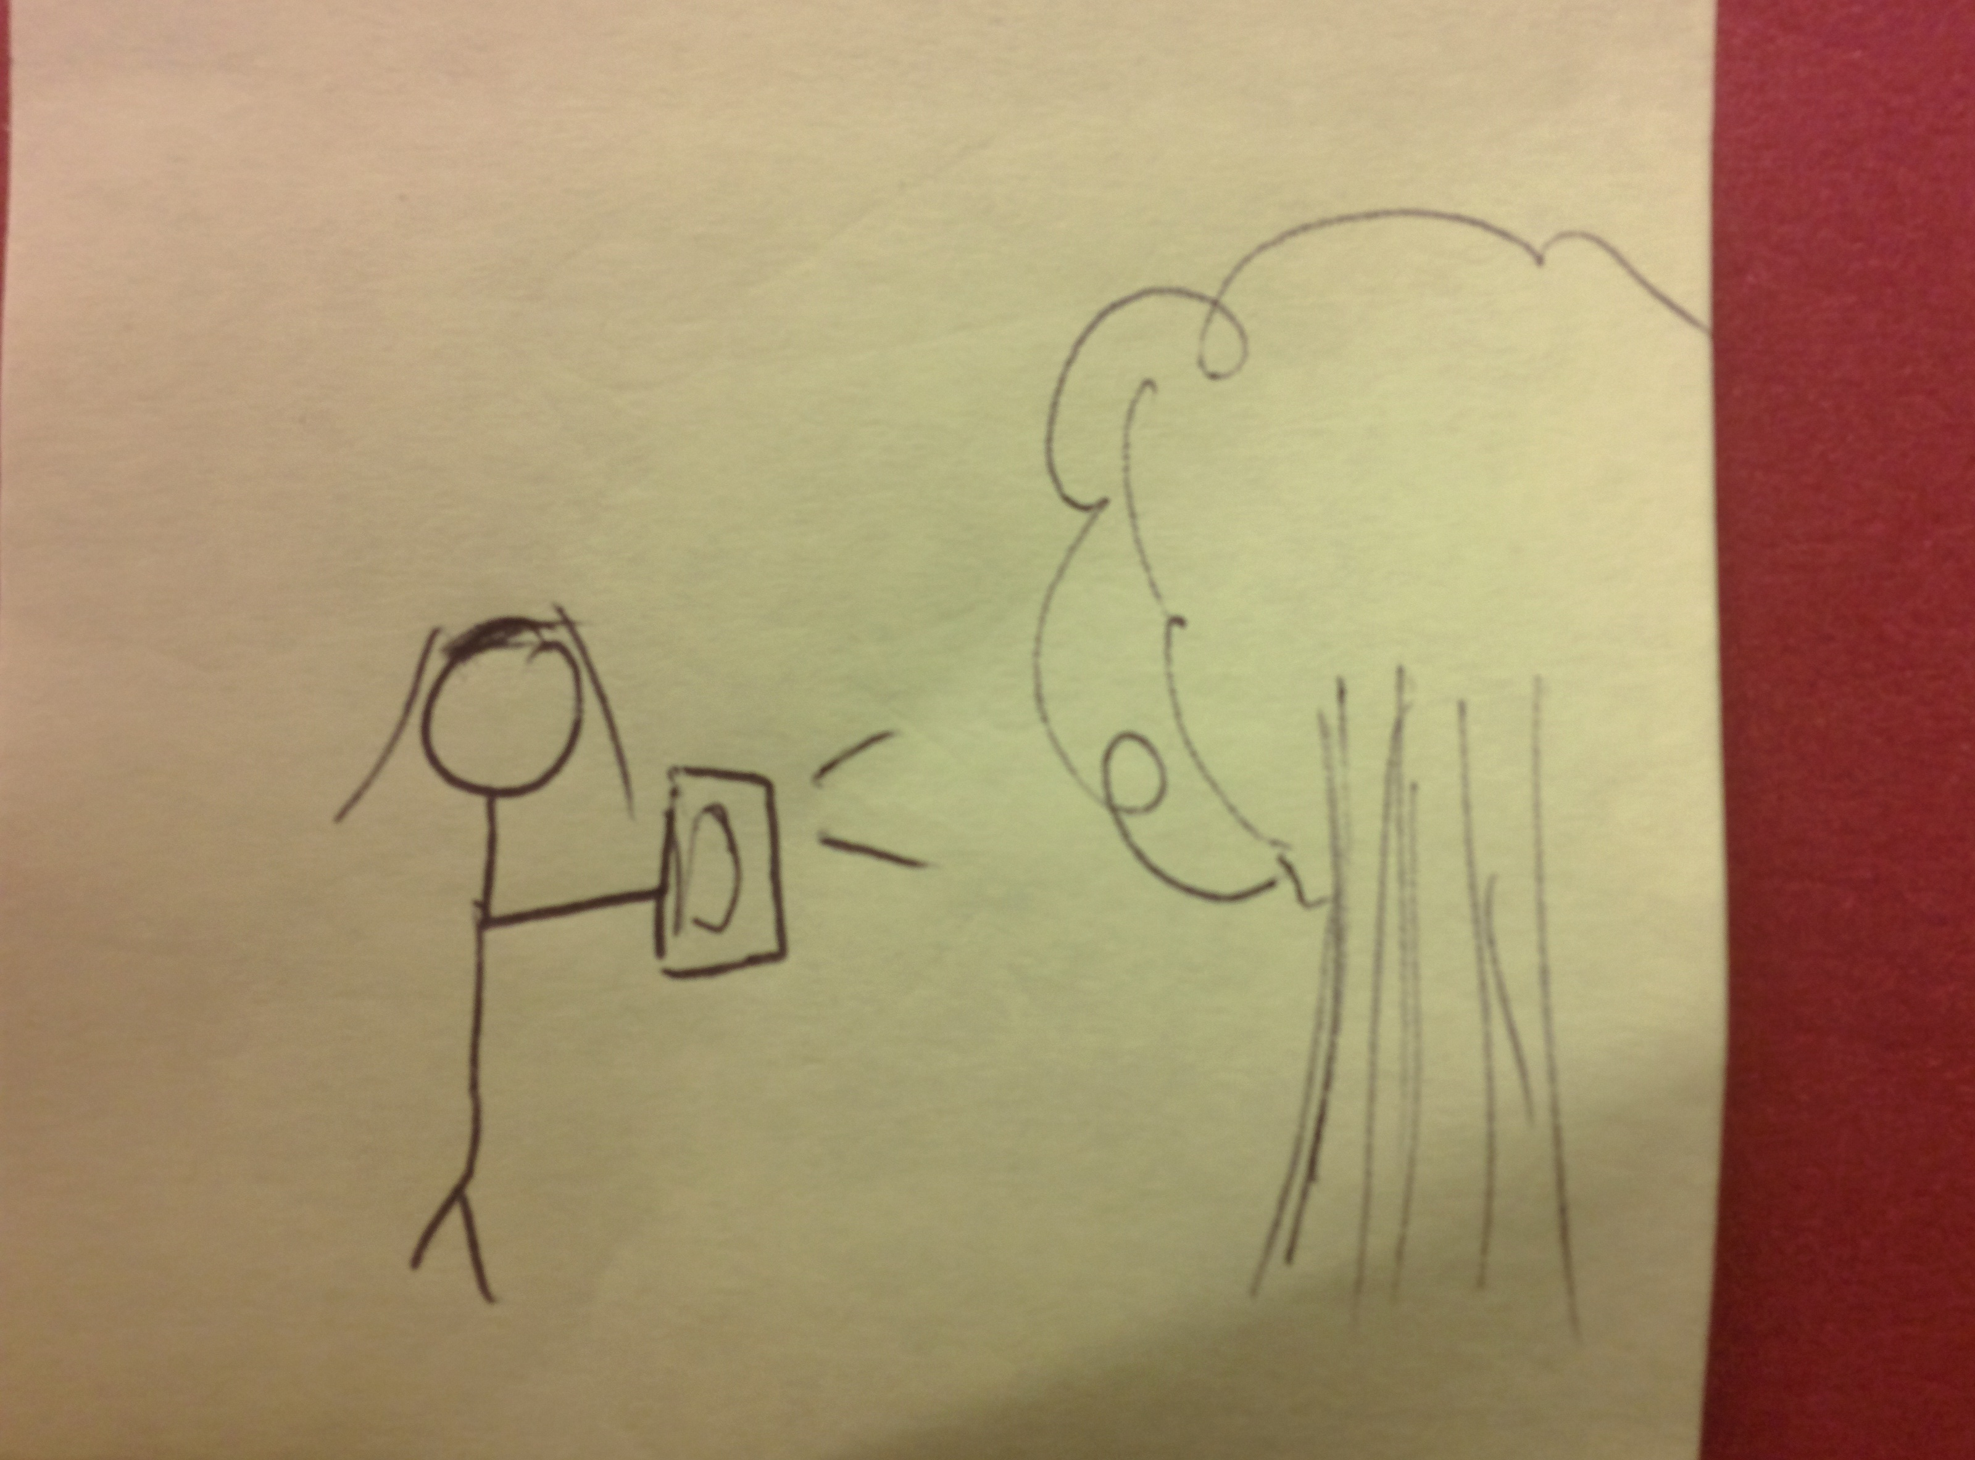
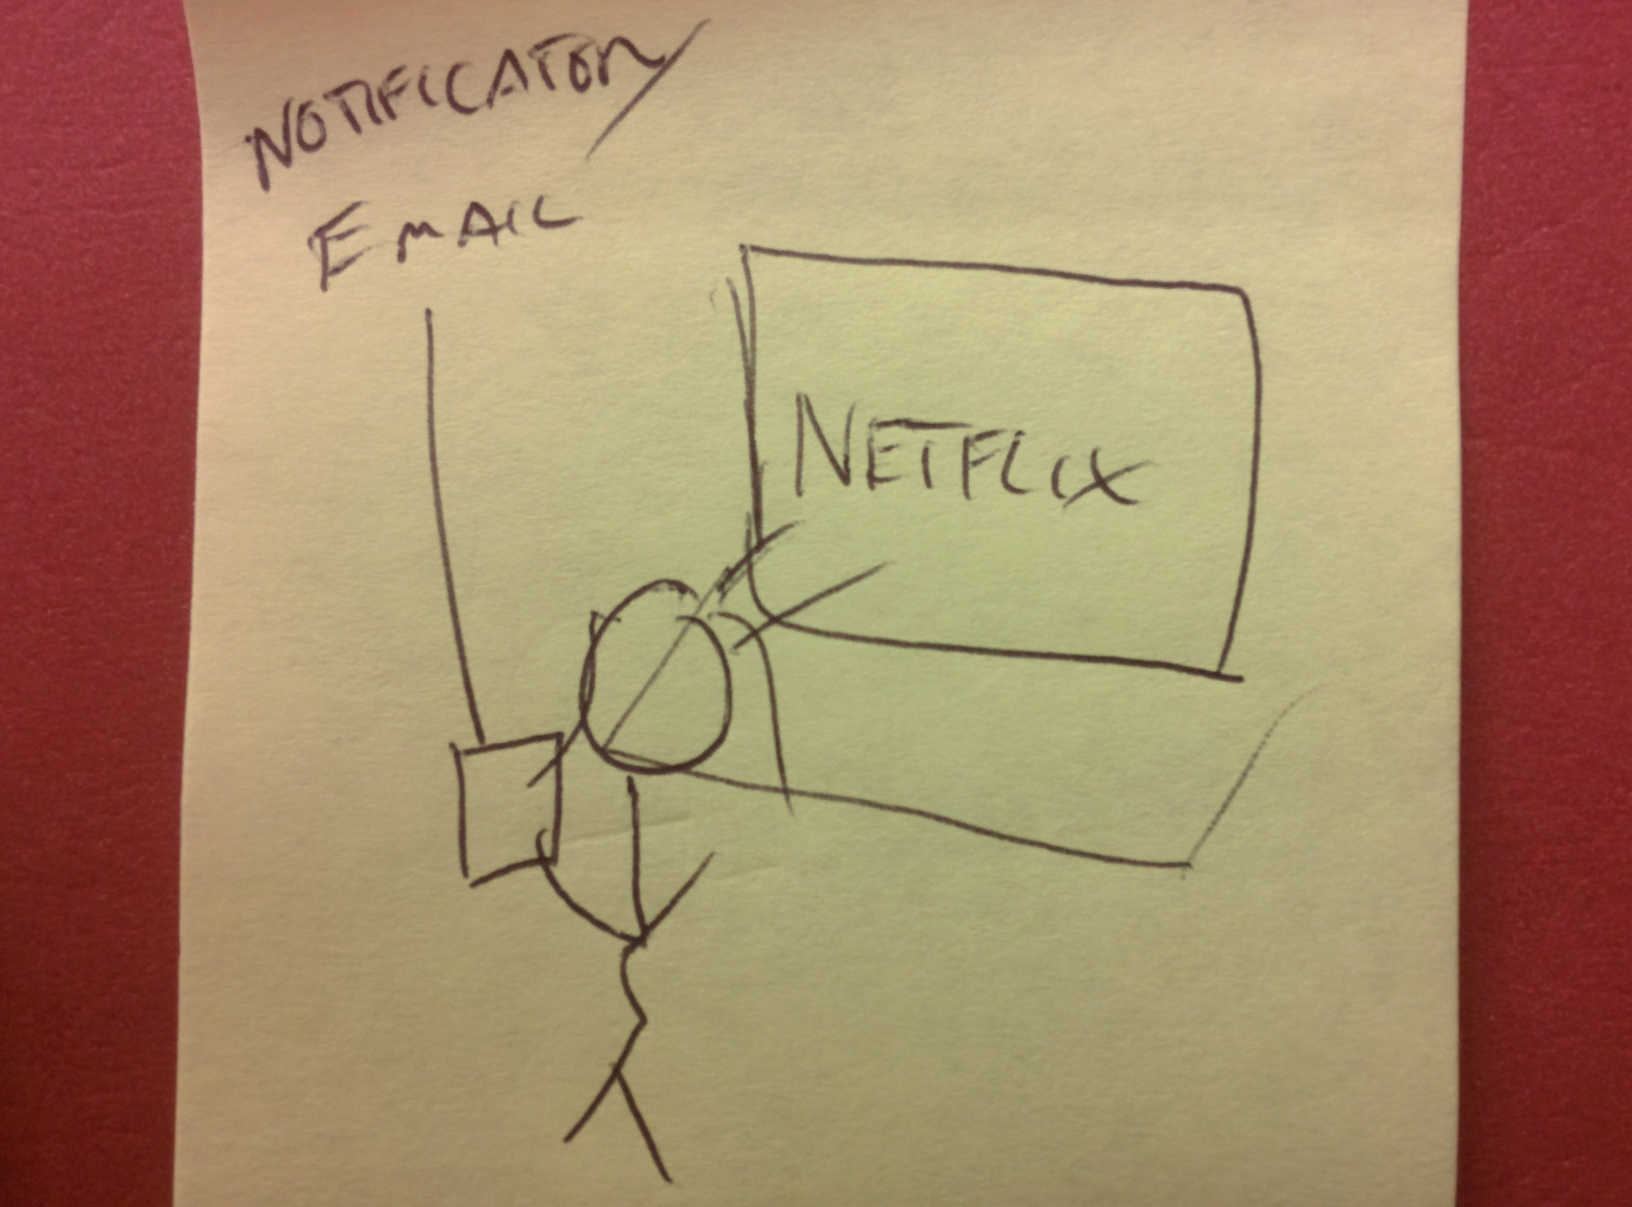
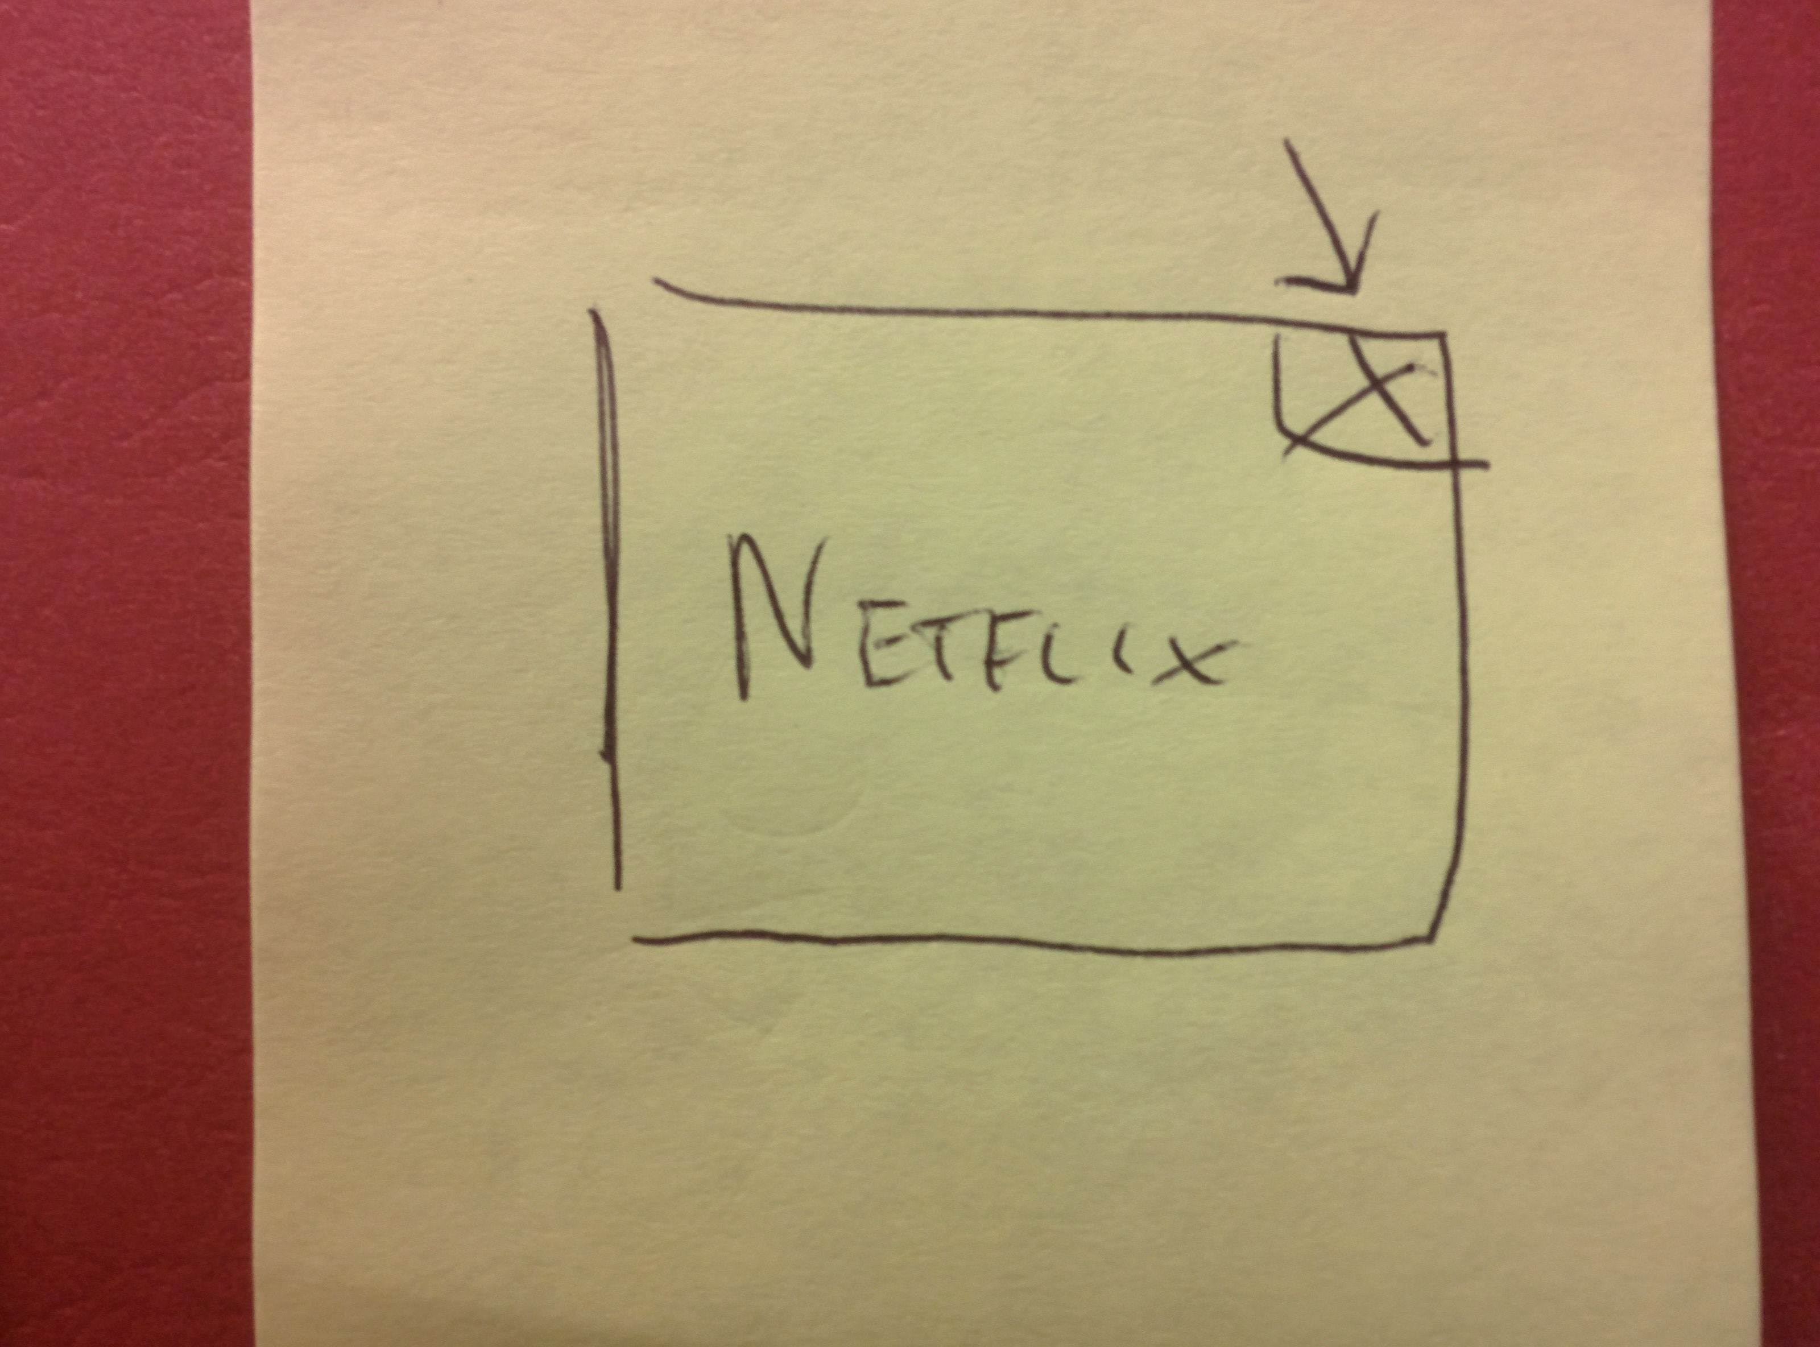
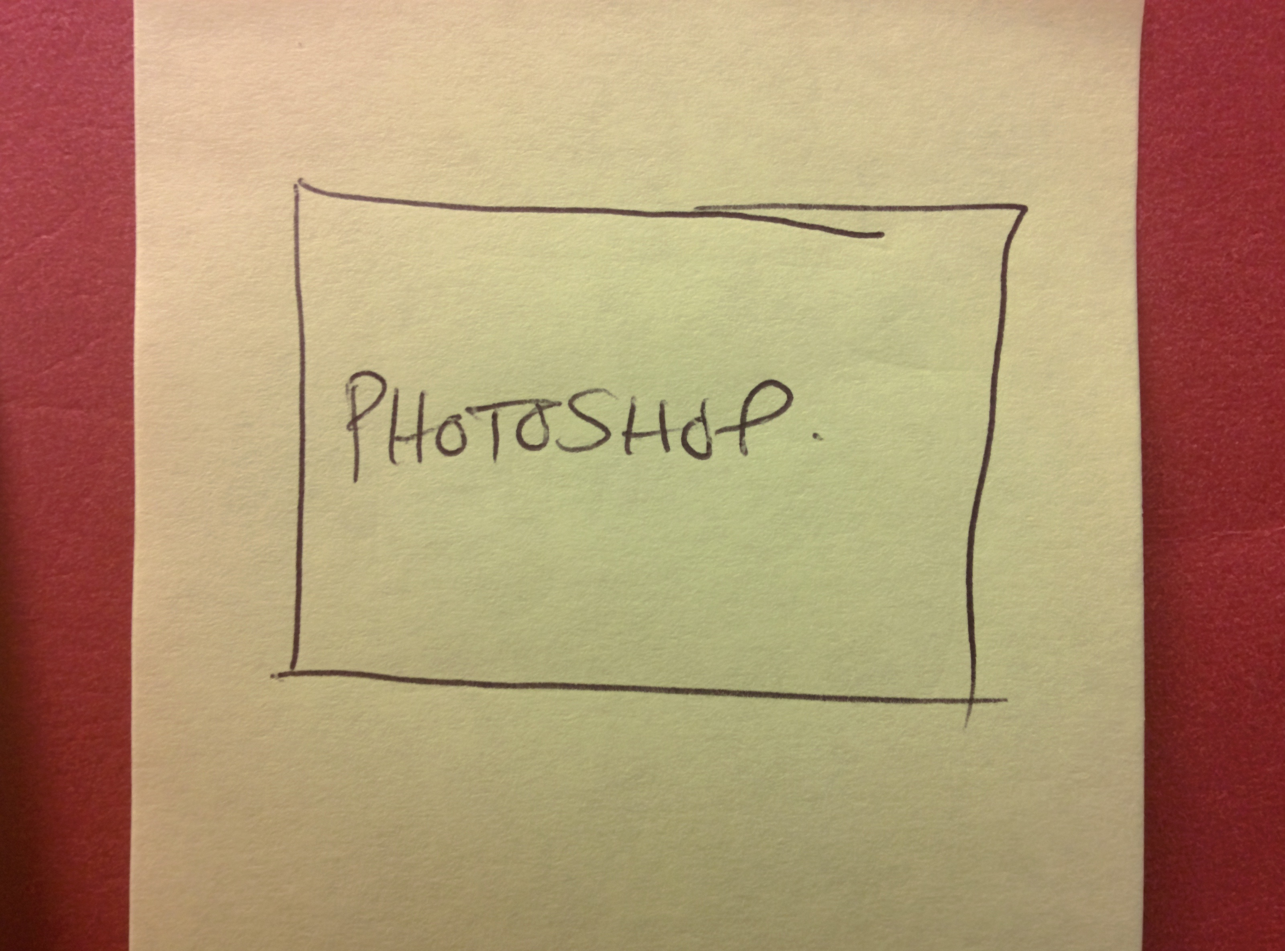
SIMPLE:
MEDIUM:
COMPLEX:

Slide 4
https://www.youtube.com/watch?v=WI2ceGC89wg&feature=youtu.be

